Slide 1
Project Highlights

Slide 2
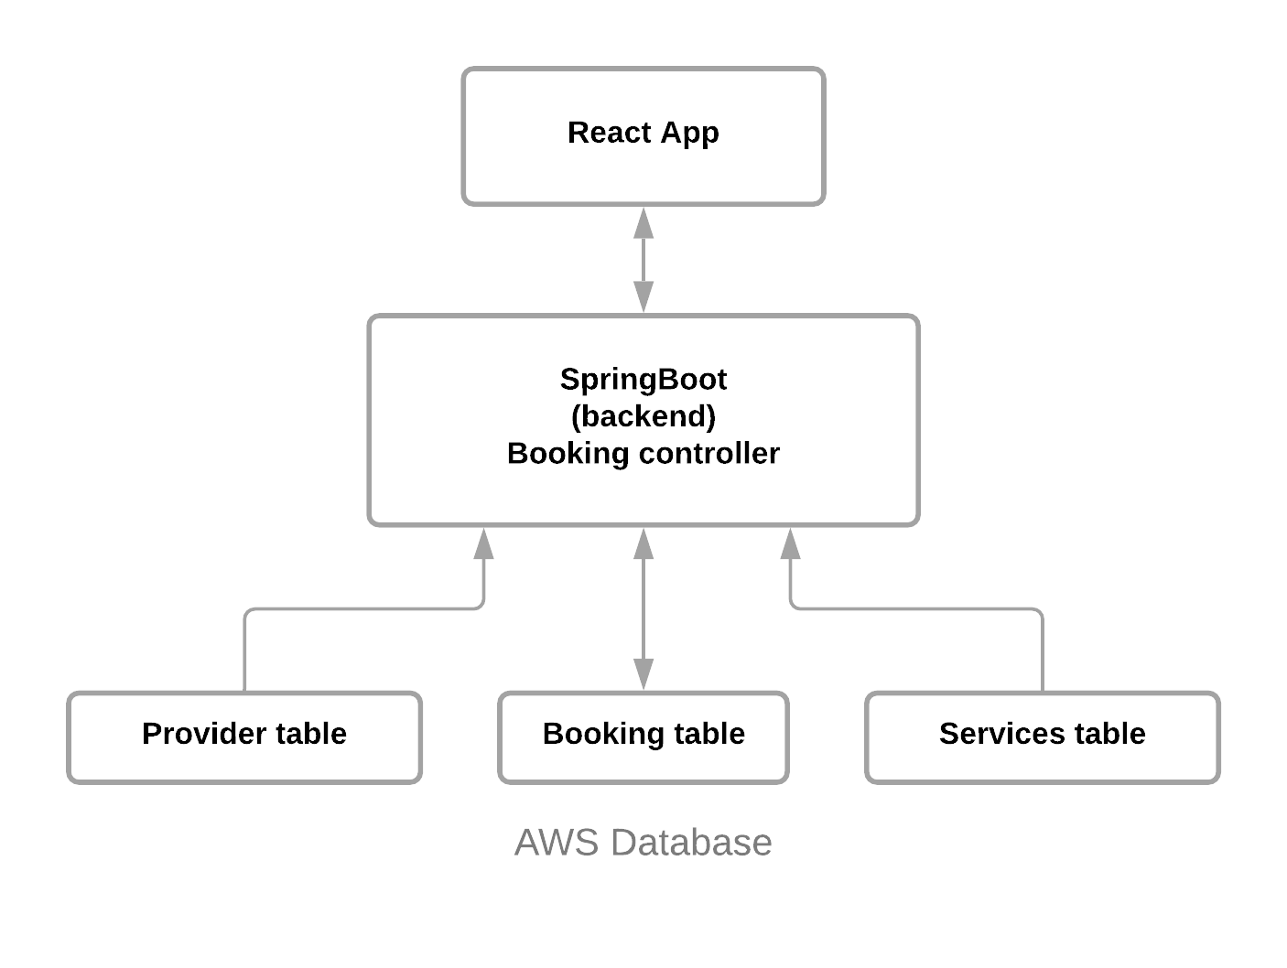
Backend: Managing booking controller with the frontend

Slide 3
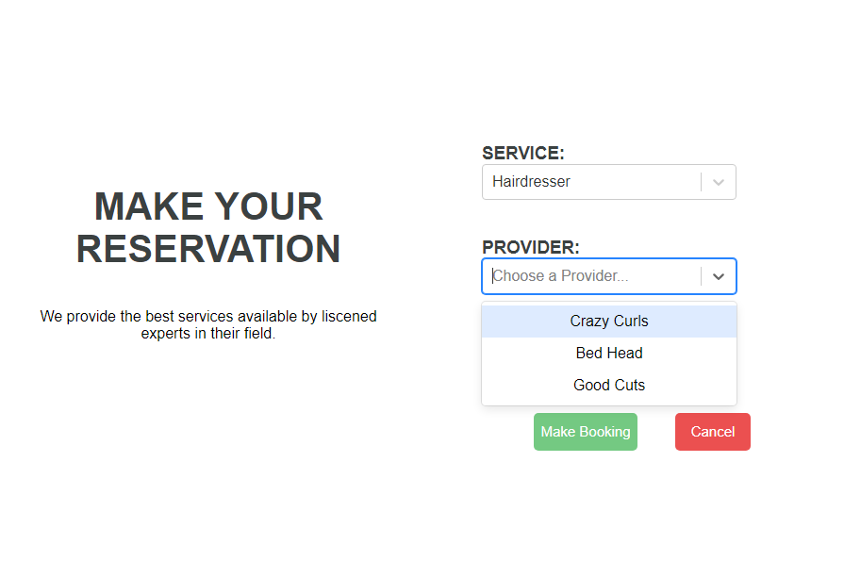
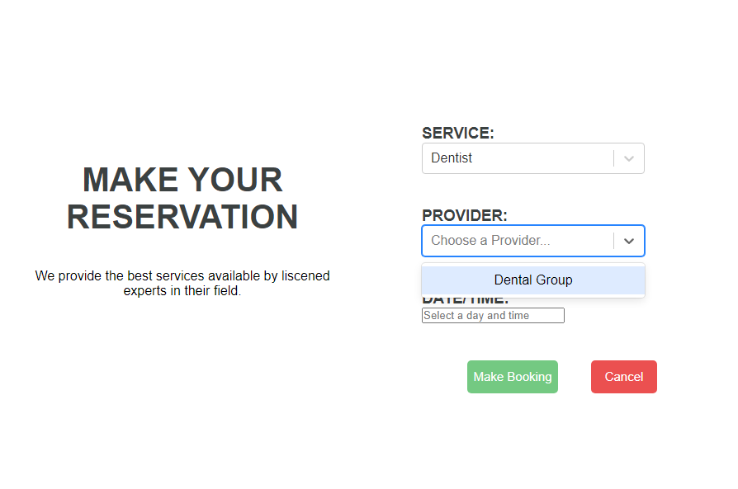
Frontend: Retrieving providers for a given Service using Axios

Slide 4
Frontend: Retrieving providers for a given Service using Axios
Functionality:
User selects a Service from one of the select options, and depending on the Service they have picked, they are given a list of providers for the Service selected. This function works by setting the state of selected Service name by calling an event handler and using that state to retrieve a list of providers using Axios for the given Service name.
Why is this interesting?
I think this is a cool functionality because it improves the user experience significantly, instead of looking up the corresponding Providers for a Service, the available providers are easily given to the user and they may select the one they prefer.
Was it challenging?
It was certainly challenging at first as I am still new to React. However after learning more about Axios and how states and event handlers work, it became a lot easier.

Slide 5
Retrospective
What worked well?
Communication between frontend and backend development was smooth
What could be improved?
More verification for user registration and prevent duplicate bookings
What "surprised" you?
We managed to get a lot done due to only two people working on the project
What did you learn?
Communication and frequent meetings can boost our progress exponentially

